Slide 1
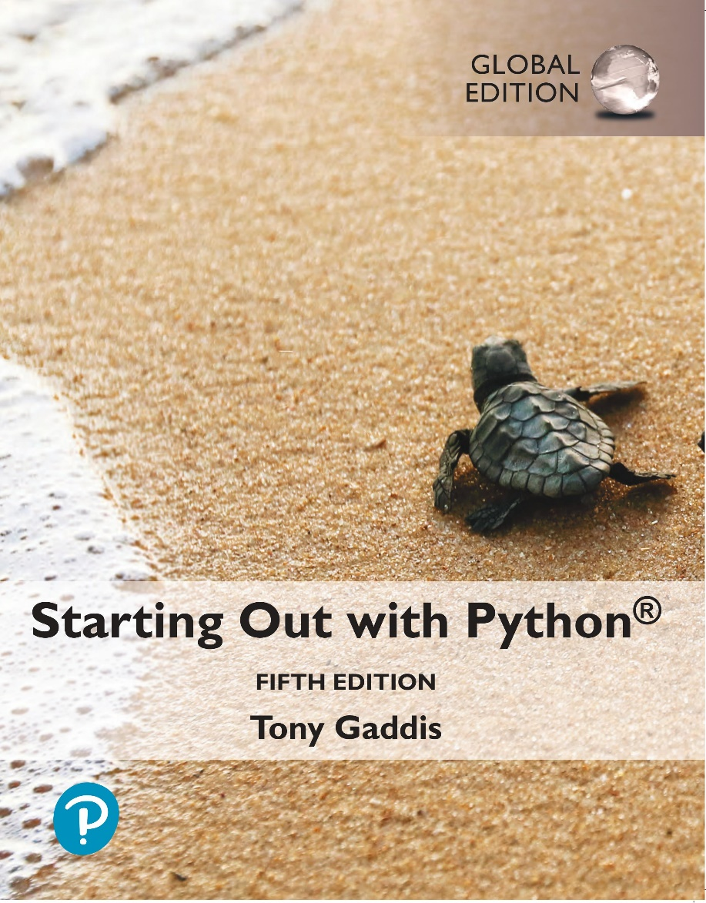
Starting out with Python
Fifth Edition, Global Edition
Chapter 9
Dictionaries and Sets
Copyright © 2022 Pearson Education, Ltd. All Rights Reserved.

Slide 2
Topics
Dictionaries

Slide 3
Dictionaries
Dictionary: object that stores a collection of data
Each element consists of a key and a value
Often referred to as mapping of key to value
Key must be an immutable object
To retrieve a specific value, use the key associated with it
Format for creating a dictionary
dictionary =
{key1:val1, key2:val2}

Slide 4
Retrieving a Value from a Dictionary
Elements in dictionary are unsorted
General format for retrieving value from dictionary: dictionary[key]
If key in the dictionary, associated value is returned, otherwise, KeyError exception is raised
Test whether a key is in a dictionary using the in and not in operators
Helps prevent KeyError exceptions

Slide 5
Adding Elements to an Existing Dictionary
Dictionaries are mutable objects
To add a new key-value pair:
dictionary[key] = value
If key exists in the dictionary, the value associated with it will be changed

Slide 6
Deleting Elements From an Existing Dictionary
To delete a key-value pair:
del dictionary[key]
If key is not in the dictionary, KeyError exception is raised

Slide 7
Getting the Number of Elements and Mixing Data Types
len function: used to obtain number of elements in a dictionary
Keys must be immutable objects, but associated values can be any type of object
One dictionary can include keys of several different immutable types
Values stored in a single dictionary can be of different types

Slide 8
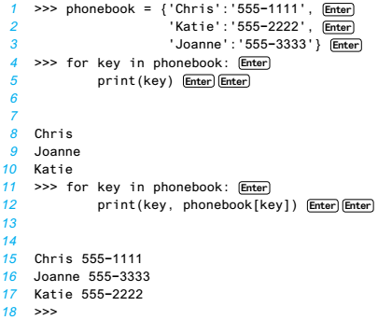
Creating an Empty Dictionary and Using for Loop to Iterate Over a Dictionary
To create an empty dictionary:
Use {}
Use built-in function dict()
Elements can be added to the dictionary as program executes
Use a for loop to iterate over a dictionary
General format:
for key in dictionary:

Slide 9
Some Dictionary Methods (1 of 5)
clear method: deletes all the elements in a dictionary, leaving it empty
Format: dictionary.clear()
get method: gets a value associated with specified key from the dictionary
Format: dictionary.get(key, default)
default is returned if key is not found
Alternative to [] operator
Cannot raise KeyError exception

Slide 10
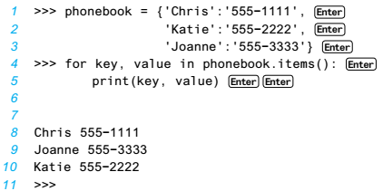
Some Dictionary Methods (2 of 5)
items method: returns all the dictionaries keys and associated values
Format: dictionary.items()
Returned as a dictionary view
Each element in dictionary view is a tuple which contains a key and its associated value
Use a for loop to iterate over the tuples in the sequence
Can use a variable which receives a tuple, or can use two variables which receive key and value

Slide 11
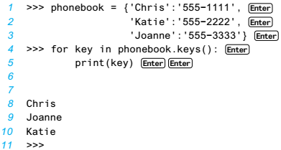
Some Dictionary Methods (3 of 5)
keys method: returns all the dictionaries keys as a sequence
Format: dictionary.keys()
pop method: returns value associated with specified key and removes that key-value pair from the dictionary
Format: dictionary.pop(key, default)
default is returned if key is not found

Slide 12
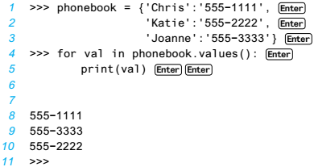
Some Dictionary Methods (4 of 5)
popitem method: Returns, as a tuple, the key-value pair that was last added to the dictionary. The method also removes the key-value pair from the dictionary.
Format: dictionary.popitem()
Key-value pair returned as a tuple
values method: returns all the dictionaries values as a sequence
Format:
dictionary.values()
Use a for loop to iterate
over the values

Slide 13
Some Dictionary Methods (5 of 5)
Table 9-1 Some of the dictionary methods
Method | Description
Clear | Clears the contents of a dictionary.
get | Gets the value associated with a specified key. If the key is not found, the method does not raise an exception. Instead, it returns a default value.
items | Returns all the keys in a dictionary and their associated values as a sequence of tuples.
keys | Returns all the keys in a dictionary as a sequence of tuples.
pop | Returns the value associated with a specified key and removes that key-value pair from the dictionary. If the key is not found, the method returns a default value.
popitem | Returns, as a tuple, the key-value pair that was last added to the dictionary. The method also removes the key-value pair from the dictionary.
values | Returns all the values in the dictionary as a sequence of tuples.

Slide 14
Örnek
Soru: Yüzlerinde SARI, KIRMIZI, MAVİ, YEŞİL, MOR VE TURUNCU renkleri olan bir zarın 1000 kez atılması sonucunda gelen renkleri kullanıcıdan alan, zarın yüzlerindeki renklerin kaçar kez geldiklerini bulan algoritma:

Slide 15
Örnek
Soru: Bir mağazada çalışan satıcıların yaptıkları her satış için satıcı adı ve satış tutarı verilerini kullanıcıdan alan, her satıcının yaptığı satışların toplam tutarını bulan algoritma:

Slide 16
Dictionary Comprehensions (1 of 6)
Dictionary comprehension: an expression that reads a sequence of input elements and uses those input elements to produce a dictionary

Slide 17
Dictionary Comprehensions (2 of 6)
Example: create a dictionary in which the keys are the integers 1 through 4 and the values are the squares of the keys
>>> numbers = [1, 2, 3, 4]
>>> squares = {}
>>> for item in numbers:
... squares[item] = item**2
...
>>> squares
{1: 1, 2: 4, 3: 9, 4: 16}
>>>
Using a for loop
Using a dictionary comprehension
>>> squares = {item:item**2 for item in numbers}
>>> squares
{1: 1, 2: 4, 3: 9, 4: 16}
>>>

Slide 18
Dictionary Comprehensions (3 of 6)
squares = {item:item**2 for item in numbers}
Result Expression
Iteration Expression
The iteration expression iterates over the elements of numbers
Each time it iterates, the target variable item is assigned the value of an element
At the end of each iteration, an element containing item as the key and item**2 as the value is added to the new dictionary

Slide 19
Dictionary Comprehensions (4 of 6)
Example: You have an existing list of strings. Create a dictionary in which the keys are the stings in the list, and the values are the lengths of the strings
>>> names = ['Jeremy', 'Kate', 'Peg']
>>> str_lengths = {item:len(item) for item in names}
>>> str_lengths
{'Jeremy': 6, 'Kate': 4, 'Peg': 3}
>>>

Slide 20
Dictionary Comprehensions (5 of 6)
Example: making a copy of a dictionary
>>> dict1 = {'A':1, 'B':2, 'C':3}
>>> dict2 = {k:v for k,v in dict1.items()}
>>> dict2
{'A': 1, 'B': 2, 'C': 3}
>>>

Slide 21
Dictionary Comprehensions (6 of 6)
You can use an if clause in a dictionary comprehension to select only certain elements of the input sequence
Example: A dictionary contains cities and their populations as key-value pairs. Select only the cities with a population greater than 2 million
>>> populations = {'New York': 8398748, 'Los Angeles': 3990456,
... 'Chicago': 2705994, 'Houston': 2325502,
... 'Phoenix': 1660272, 'Philadelphia': 1584138}
>>> largest = {k:v for k,v in populations.items() if v > 2000000}
>>> largest
{'New York': 8398748, 'Los Angeles': 3990456, 'Chicago': 2705994, 'Houston': 2325502}
>>>

Slide 22
Summary
This chapter covered:
Dictionaries, including:
Creating dictionaries
Inserting, retrieving, adding, and deleting key-value pairs
for loops and in and not in operators
Dictionary methods

